Slide 1
Skin Cutaneous Melanoma (SKCM):Multi-Omics Analysis
UnderSupervision of:
Dr. Mohamed Mysara

Slide 2
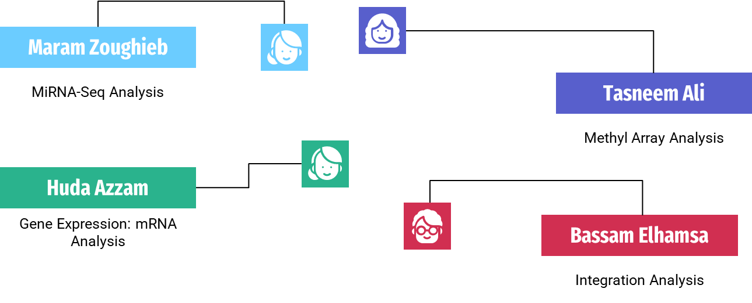
Team Project

Slide 3
Table of content
01
02
03
04
Introduction
MiRNA-seq Analysis
Gene Expression: mRNA Analysis
Methyl Array Analysis
05
Integration Analysis
06
References

Slide 4
01
Introduction

Slide 5
Introduction
Skin cutaneous melanoma is an aggressive form of skin cancer that arises from melanocytes, the pigment-producing cells of the skin. It poses a significant public health concern globally, with increasing incidence rates reported in many countries.
Risk factors for skin cutaneous melanoma include excessive UV radiation exposure, fair skin complexion, history of sunburns, family history of melanoma, presence of atypical moles, certain genetic mutations, and weakened immune system. Early detection and treatment are crucial to prevent the spread of the cancer.
Recent studies have focused on the potential role of the human microbiota, the diverse community of microorganisms in and on the human body, in the development and progression of skin cutaneous melanoma. Analysis of bacterial communities in tumors and surrounding skin has been conducted, leading to the creation of the Bacterial In Cancer (BIC) database, which provides information on the abundance, diversity, and clinical relevance of bacteria associated with different cancer types, including skin cutaneous melanoma. Further research is needed to fully understand the complex interactions between the microbiota and the development of this aggressive form of skin cancer and to explore new diagnostic, treatment, and prevention strategies.

Slide 6
02
MiRNA-Seq Analysis

Slide 7
MiRNA-Seq Analysis
First, we received the data from Multi-Omics Cancer Benchmark TCGA Preprocessed Data, it contains 3 main files which are miRNA, exp and methyl.
The main of miRNA contains 1,046 rows, 452 total columns
Meta data contains 481 rows, 102 total columns.
As well as we checked data, vital status column 227 living and 253deceased, also we have 183 females and 297 males.
Checking the NAs values, substituting dotted in MiRNA data and dashed in metadata (melanoma) to make the same dashed in both and intersecting MiRNA data and metadata to make columns of MiRNA data equal rows of metadata to apply deseq2.

Slide 8
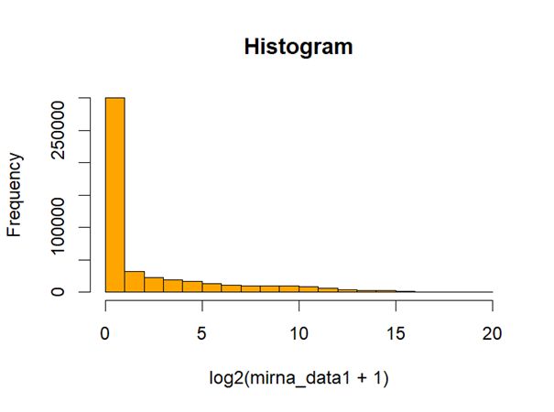
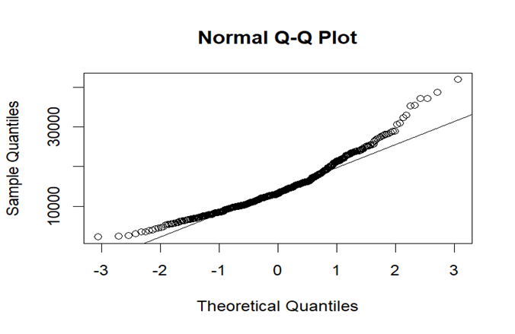
MiRNA-Seq Analysis
1.1: MiRNA RESULTS
A) Normality check
Figure 1: Histogram for the dataset.
Figure 2: QQ-Plot

Slide 9
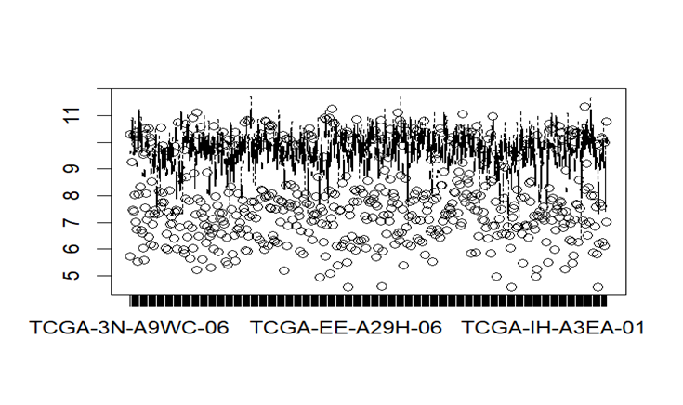
MiRNA-Seq Analysis
1.1: MiRNA RESULTS
B) Variance check "Box Plot"
Figure 3: Boxplot Shows Variance

Slide 10
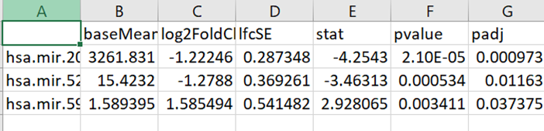
MiRNA-Seq Analysis
1.1: MiRNA RESULTS
D) DEseq2 Results
The obtained deseq.deg file represents the upregulation and downregulation of miRNAs associated with survival and death cases in SKEM
miRNA is indicated through the relation between numeric values in log2 foldchange>0.5,it gives 20 miRNA biomarkers, then indicated through the relation between numeric values in log2 foldchange>1.2 and adjusted p-value<0.05 to reduce miRNA biomarkers so we got 3 miRNA.
Table1: snapshot of Deseq2 Results

Slide 11
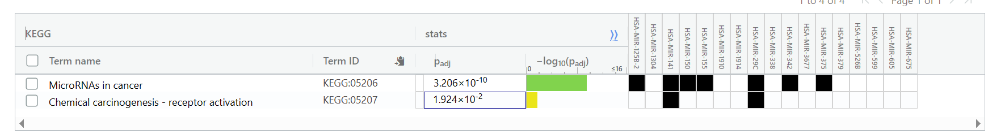
MiRNA-Seq Analysis
1.1: MiRNA RESULTS
E)Functional Enrichment Analysis Results using G-Profiler and KEGG:
1. based on the adjusted p-values provided, "MicroRNAs in cancer" appears to be more significant in the KEGG results compared to "Chemical carcinogenesis - receptor activation."
Table2: G-profiler Results for 20 biomarkers using 0.5 log2 fold change

Slide 12
MiRNA-Seq Analysis
1.1: MiRNA RESULTS
E)Functional Enrichment Analysis Results using G-Profiler and KEGG:
A query length of 3 using log2 fold change in g:Profiler may not yield any results in the KEGG pathway database due to limitations on the minimum number of genes or molecules required for pathway enrichment analysis.
Shorter query lengths may not have well-defined pathways associated with them, as pathways often involve interactions between multiple genes or molecules. Therefore, g:Profiler may not find any relevant pathways for a query length of 3.

Slide 13
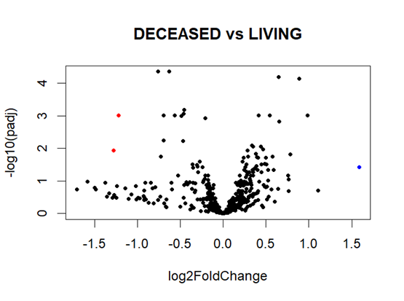
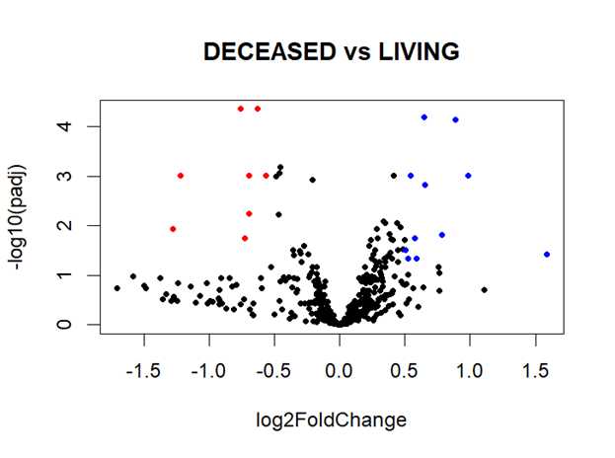
MiRNA-Seq Analysis
1.1: MiRNA RESULTS
F)Volcano plot
1.2
0.5
Figure 4: Volcano plots of DEGs (padj < 0.05 and |log 2 (Fold change)| > 0.5 (right ) & 1.2 (left) of among living and diseased samples. The x-axis represents the log 2 (Fold change), while y-axis represents statistical significance for each gene. Blue dots indicate significantly up-regulated genes and while red dots indicate significantly down-regulated genes.

Slide 14
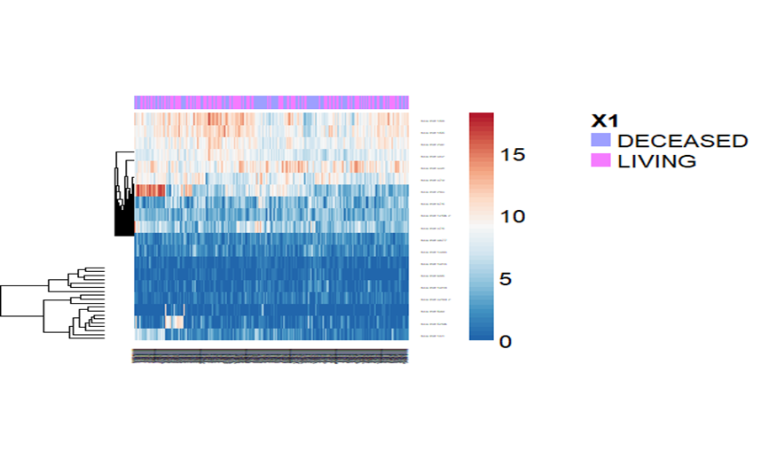
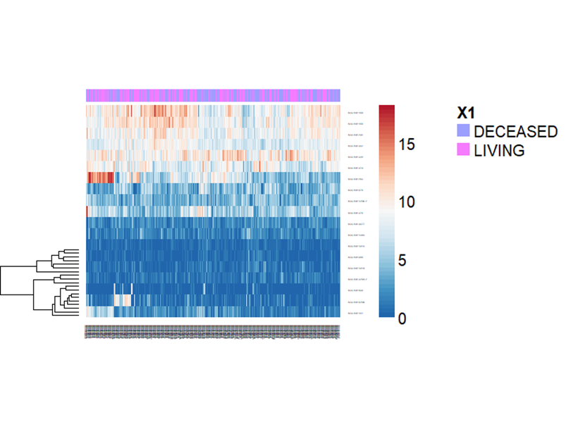
MiRNA-Seq Analysis
1.1: MiRNA RESULTS
G) Heatmap
Log2foldchange 1.2
Log2 foldchange 0.5
Figure 5:: heat maps of DEGs using two fold change values (0.5 & 1.2). Red is used to represent genes which were up-regulated, and blue is used to represent genes which were downregulated.

Slide 15
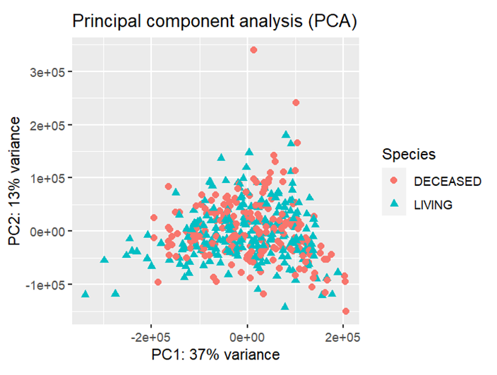
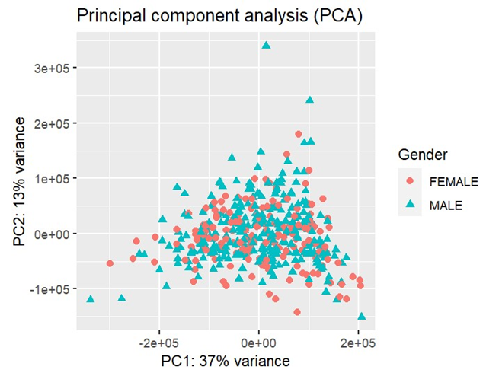
MiRNA-Seq Analysis
1.1: MiRNA RESULTS
H) Visualization of PCAs
Vital_status
Figure 6:: shows two PCA plots. The left one cluster the data the data according to vital tatus effect. The right one cluster the data the data according to gender effect. Variance that capture in the analysis is sample (50 %) so, no defined clusters are visualized

Slide 16
03
Gene Expression: MRNA Analysis

Slide 17
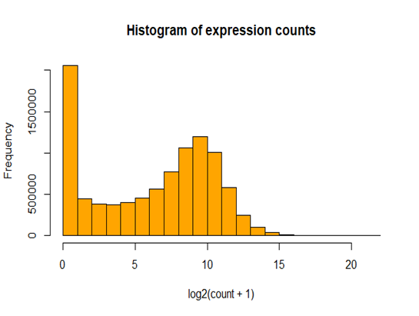
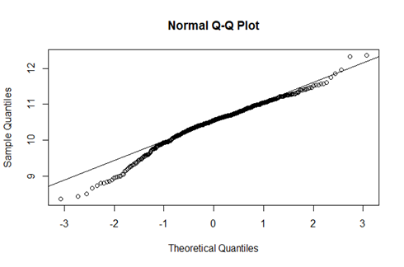
Gene expression Analysis
1.Narmaliy Check
Zero inflated negative binomial distribution count data
QQ plot shows that count data are not normally distributed

Slide 18
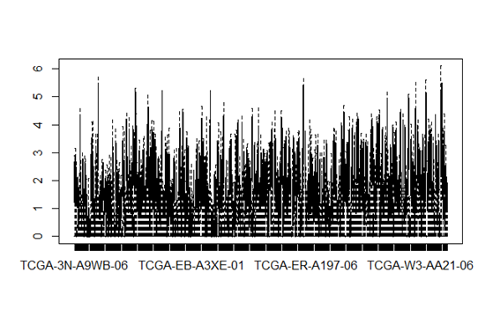
Gene expression Analysis
2.Variance check
Boxplots of count data for first 4 samples across all genes

Slide 19
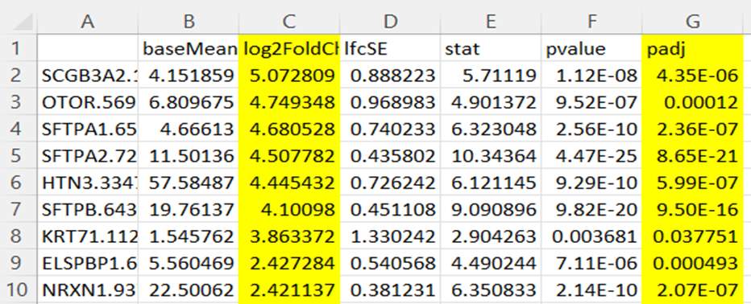
Gene expression Analysis
3. DeSeq2 tool for differential expression analysis
Screenshot of DeSeq2 output ( 943 DEGs- 0.5 FC)

Slide 20
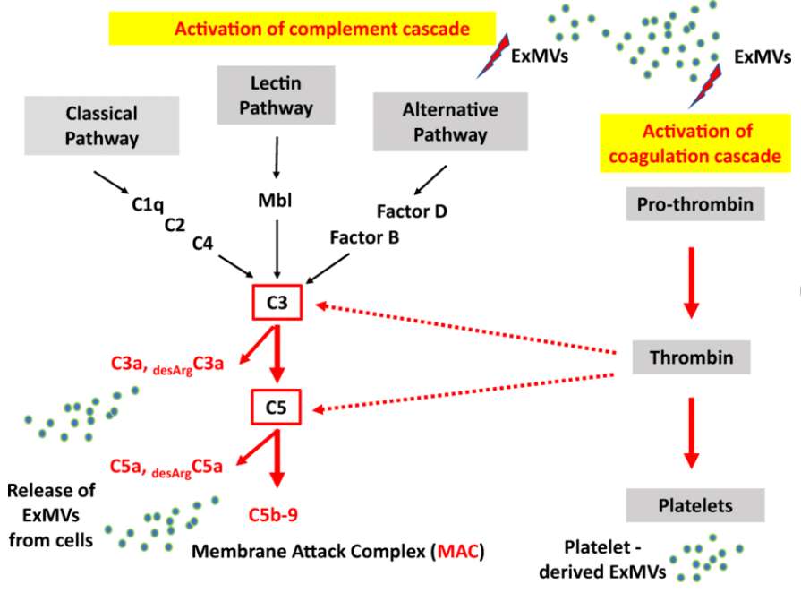
Gene expression Analysis
4. Functional analysis
Resulted DEGs showed to be contributed into complement and coagulation cascades (KEGG: 04610)
(Ratajczak et al, 2021)

Slide 21
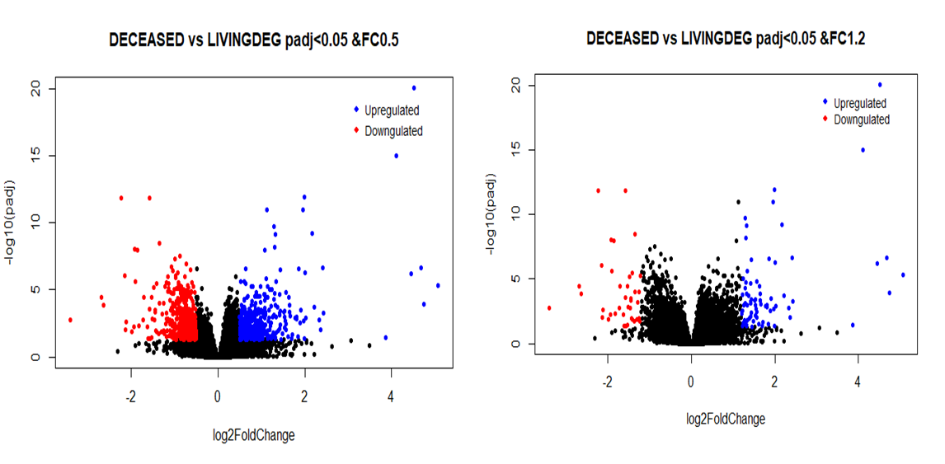
Gene expression Analysis
5. Visualization by Volcano plots
Volcano plots of DEGs (padj < 0.05 and |log 2 (Fold change)| > 0.5 (right ) & 1.2 (left). The x-axis represents the log 2 (Fold change), while y-axis represents statistical significance for each gene.

Slide 22
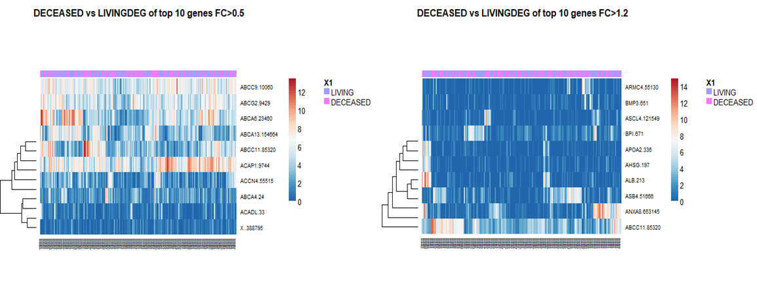
Gene expression Analysis
6. Visualization by heatmaps
Heat maps of first 10 DEGs across all samples. Red is used to represent genes which were up-regulated, and blue is used to represent genes which were down-regulated.
.

Slide 23
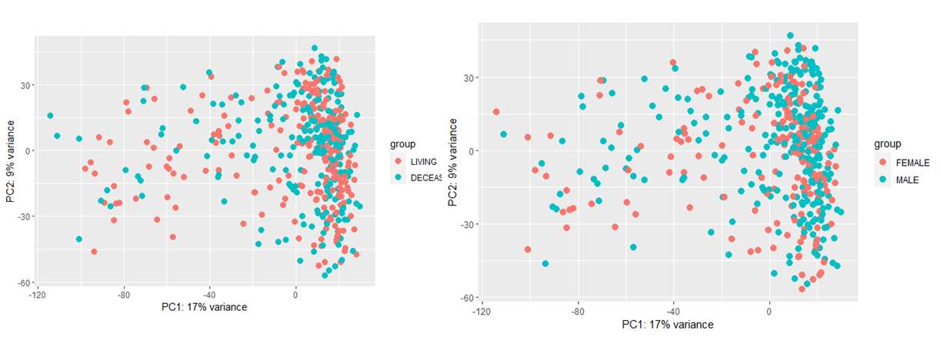
Gene expression Analysis
7. Visualization by PCAs
The left one cluster the data the data according to vital satus effect. The right one cluster the data the data according to gender effect. Small variance have been captured in the analysis (only 26 %) so, no defined clusters are visualized.

Slide 24
04
Methyl Array Analysis

Slide 25
Upstream Analysis
Read the methylation data containing beta values of 5000 CPGs (raws) for 475 individual (columns) and the metadata contains 481 samples (rows) and 103 columns and convert beta matrix into M matrix using the following equation M=log2 (beta)/ (1-beta).
match sample names in metadata with sample names in the methylation data to make them with the same number and special characters.
Normalize the methylation data using M matrix and convert M matrix after normalization into beta matrix using the following equation beta=2^M/(2^M+1).
Get 450K annotation data and convert beta matrix into file GenomicRatioSet class to be ready for filteration.
Filtering(Exclude X and Y chromosomes, Filter probes with known SNPs, Filter out cross reactive probes) to remove any uninterested source of variability.
check data distribution using histogram and density plot .

Slide 26
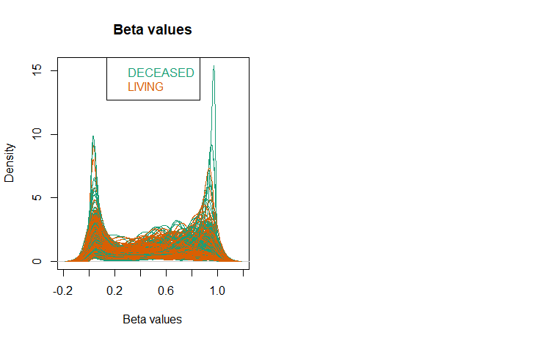
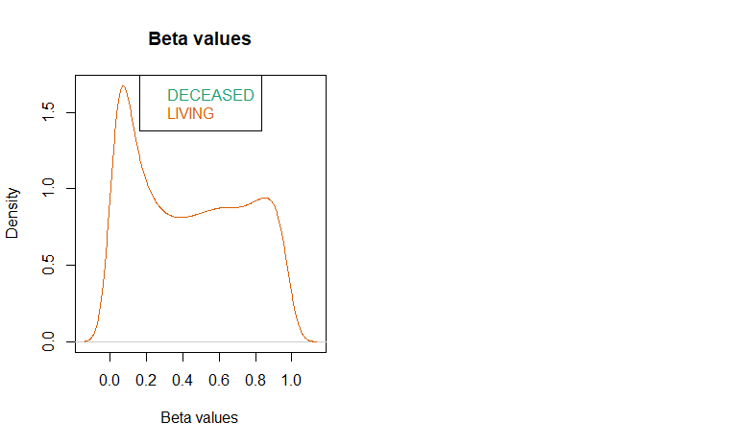
Upstream Analysis
Density plot for the methylation data using beta matrix after and before normalization

Slide 27
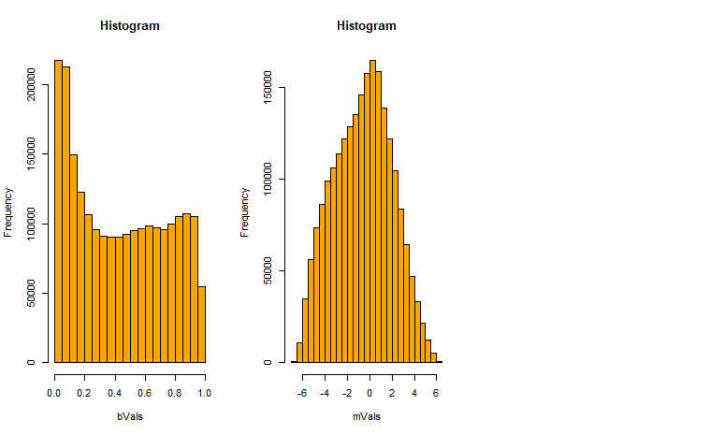
Upstream Analysis
Check data distribution
Histogram plot show bimodel distribution of methylation data using beta values and normal distribution of methylation data using M values.

Slide 28
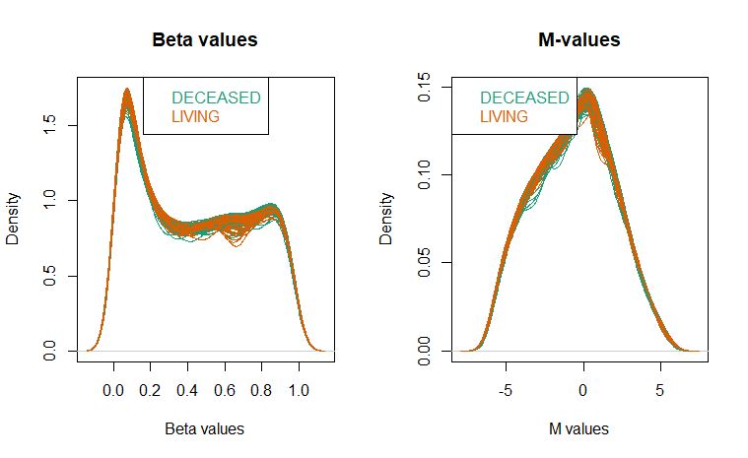
Upstream Analysis
Check data distribution
Density plot show bimodel distribution of methylation data using beta values and normal distribution of methylation data using M values.

Slide 29
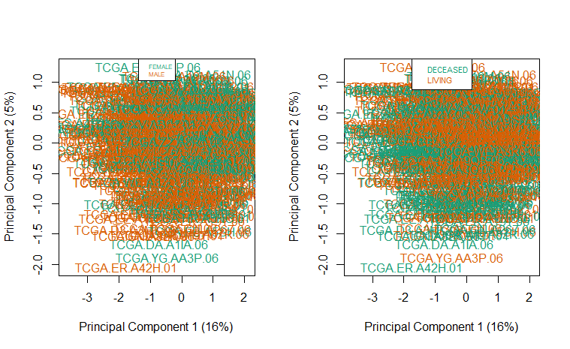
Upstream Analysis
MDS plot before filteration
MDS plot using vital status and gender features show that both features show the same variability 5% at PC2 and 16% at PC1. Variance that capture in the analysis is (21 %) so, no defined clusters are visualized.

Slide 30
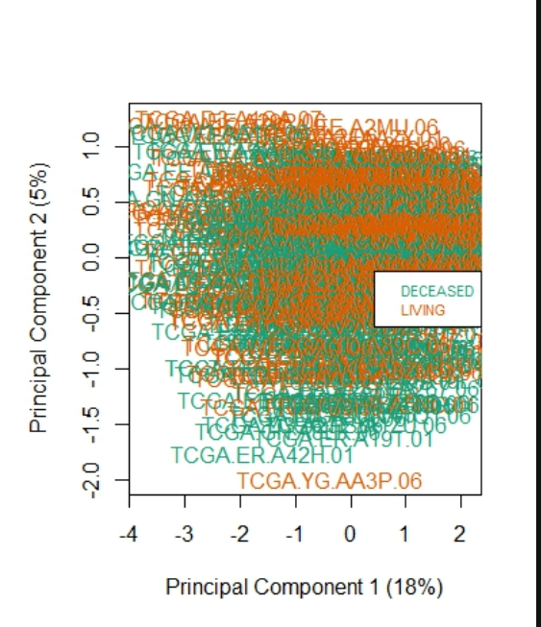
Upstream Analysis
MDS plot after filteration
MDS plot show the real variance between deseased and living 5% at PC2 and 18% at PC1. Variance that capture in the analysis is (23 %) so, no defined clusters are visualized.

Slide 31
Downstream Analysis
1/ Probe-wise differential methylation analysis , plot the top 4 most significantly differentially methylated CpGs , volcano plot to show the most significantly differentially methylated CpGs (171 CpGs) and heatmap to show the difference in methylation of the most significant CpGs across the different samples (deseased and living).
2/ Differential methylation analysis of regions.

Slide 32
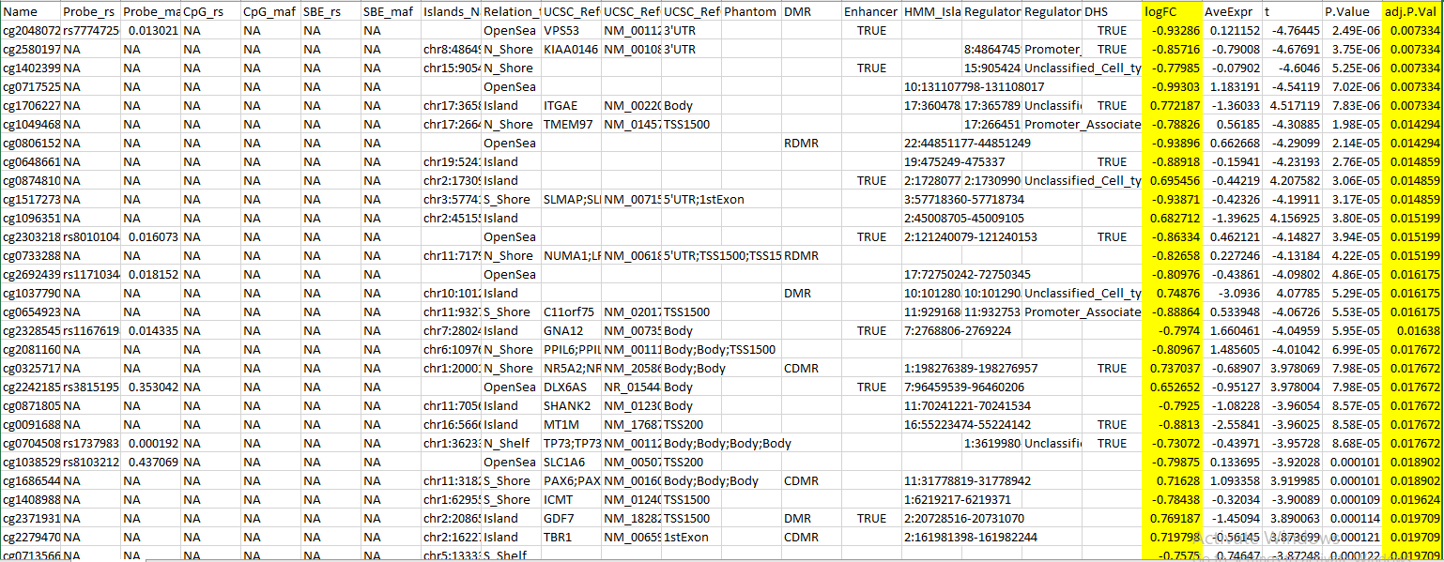
Downstream Analysis
DMPs file
DMPs file show the two columns which I used to determine the most significant CpGs

Slide 33
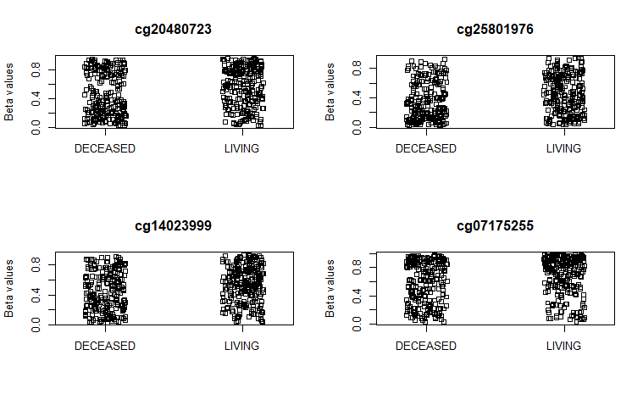
Downstream Analysis
Plot CpG
plot show the top 4 most significantly differentially methylated CpGs

Slide 34
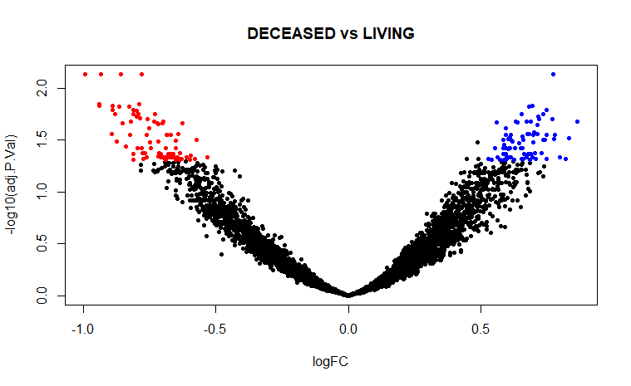
Downstream Analysis
Volcano plot
volcano plot show the unsignificantly differentially methylated CpGs in black color , the upregulated differentially methylated CpGs in blue color and downregulated differentially methylated CpGs in red color.

Slide 35
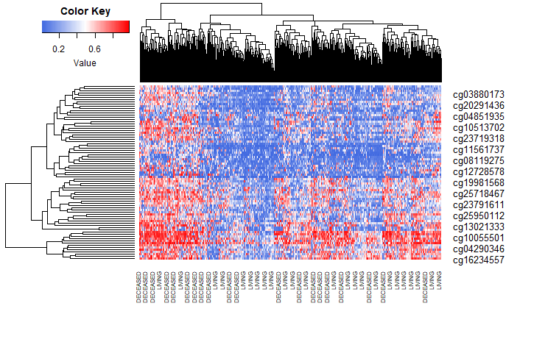
Downstream Analysis
Heatmap
Heatmap show the difference in methylation of the most significant CpGs across the different samples (deseased and living)

Slide 36
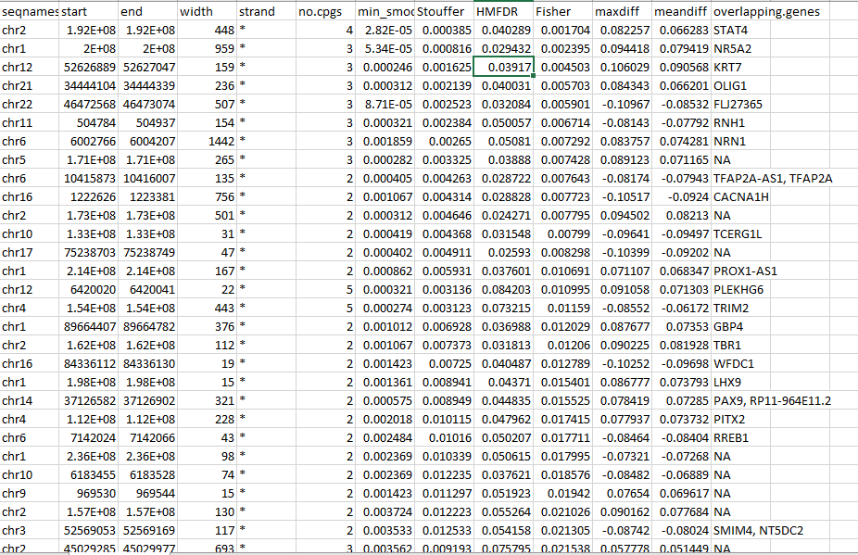
Downstream Analysis
DMRs file

Slide 37
Enrichment analysis
Kegg pathways invloved with CpGs:
1/ conducting a gene set analysis on DNA methylation data using the GO collection and then displaying the top 10 results. The analysis could provide insights into how specific gene sets or pathways are associated with the observed DNA methylation patterns in the given CpG sites.
2/ conducting a gene set analysis specifically on differentially methylated regions (DMRs) using the GO collection and Illumina 450K BeadChip data. The top 20 results of this analysis are then displayed, providing insights into how specific gene sets or pathways are associated with the observed DNA methylation patterns in the significant DMRs.

Slide 38
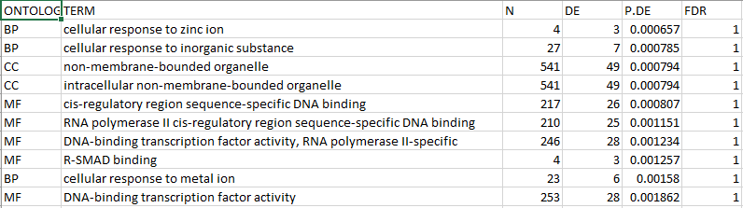
Enrichment analysis
The top 10 results of gene pathways associated with the observed DNA methylation patterns in the given CpG sites.

Slide 39
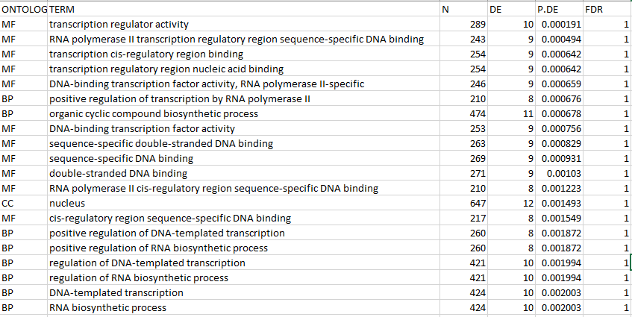
Enrichment analysis
The top 20 results of gene pathways are associated with the observed DNA methylation patterns in the significant DMRs.

Slide 40
05
Integration Analysis

Slide 41
Integration Analysis Preprocessing
At this point we have:
Normalized Expression Count table with 20531 genes across 473 samples
Normalized miRNA Count table with 1046 miRNAs across 452 samples
Normalized Methylation Count table with 4683 loci through 475 samples

Slide 42
Integration Analysis Preprocessing
At the end we have 476 samples:
450 have count tables across the 3 layers
22 have count tables across Methylation and Expression
1 sample has count tables across Methylation and miRNA
1 sample has count tables across Expression and miRNA
2 samples have count table in Methylation only

Slide 43
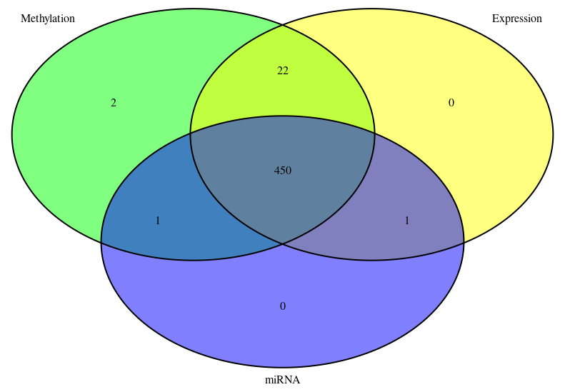
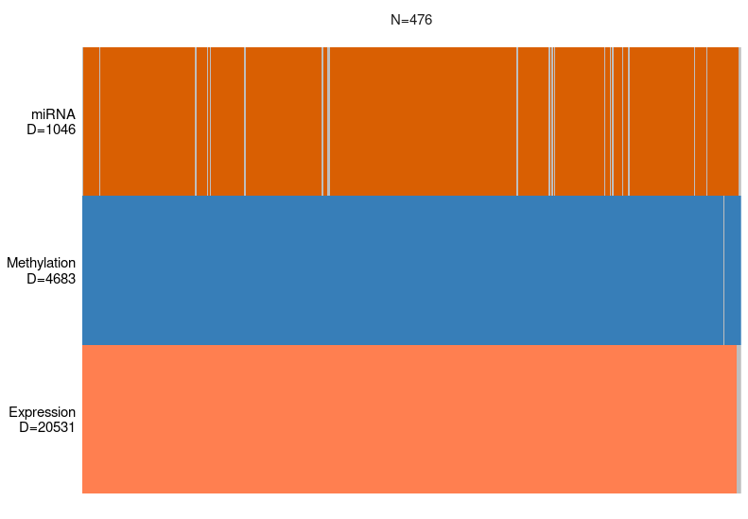
Venn diagram illustrating overlapping samples across the 3 layers
Overview plot of the samples across the 3 layers

Slide 44

Integration Analysis
After preprocessing step, We use MOFA to perform statistical multi-omics data integration analysis.
We use the following training and fitting parameters:
Number of estimated factors = 15
Number of views = 3 which are Expression, miRNA and Methylation
Data distributions for the 3 views are gaussian

Slide 45
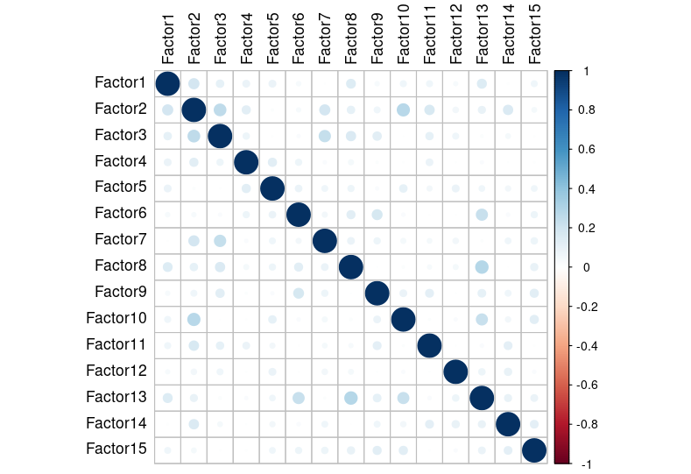
Quality check
Checking if the model ran correctly by checking
the correlation between the factors.
Each factor highly
correlate with itself which is normal.
Correlation plot of MOFA factors

Slide 46
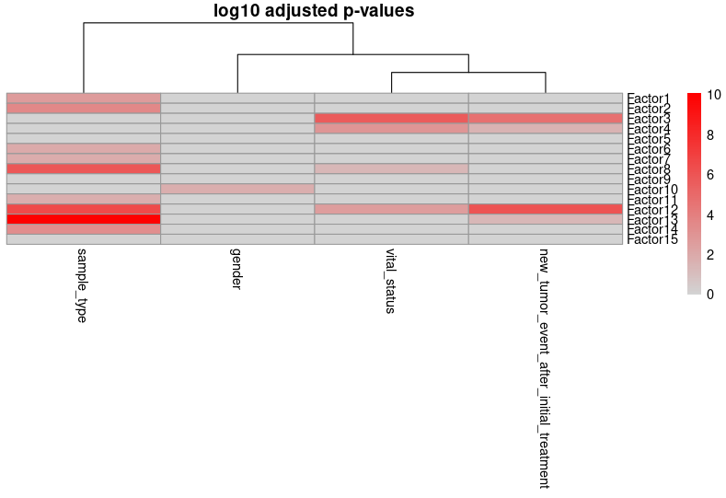
Correlation of factors to metadata
Heatmap correlating factors to metadata columns

Slide 47
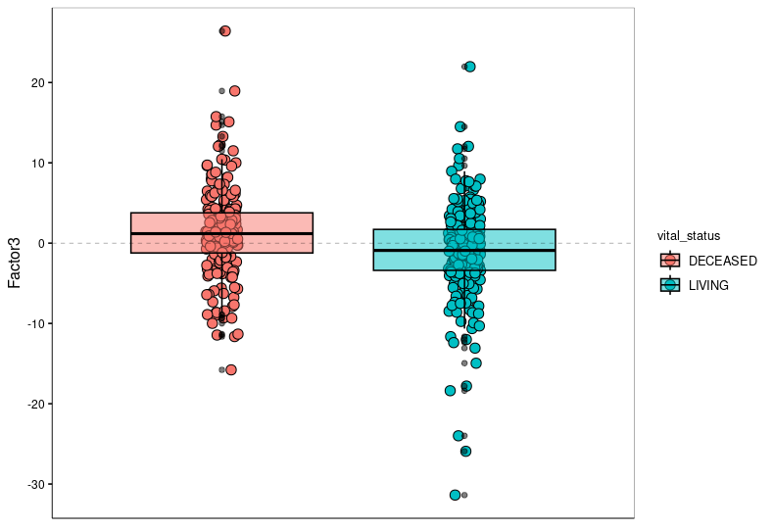
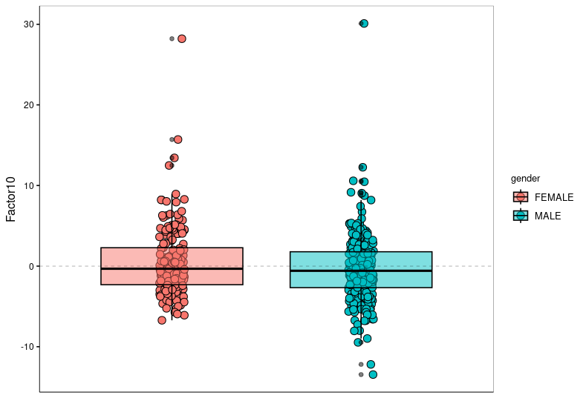
Trying to identify factors using metadata
Scatter plot of factor 3 grouped by vital status
Scatter plot of factor 10 grouped by Gender

Slide 48
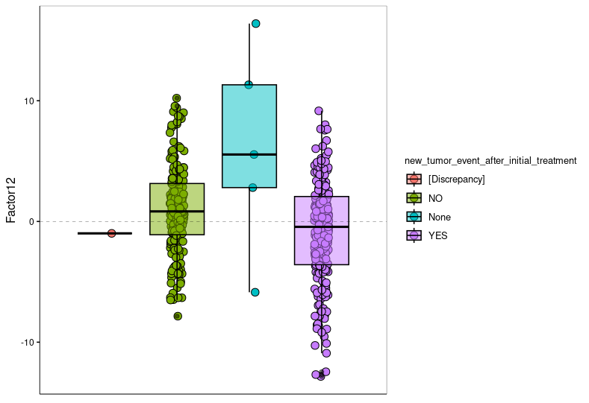
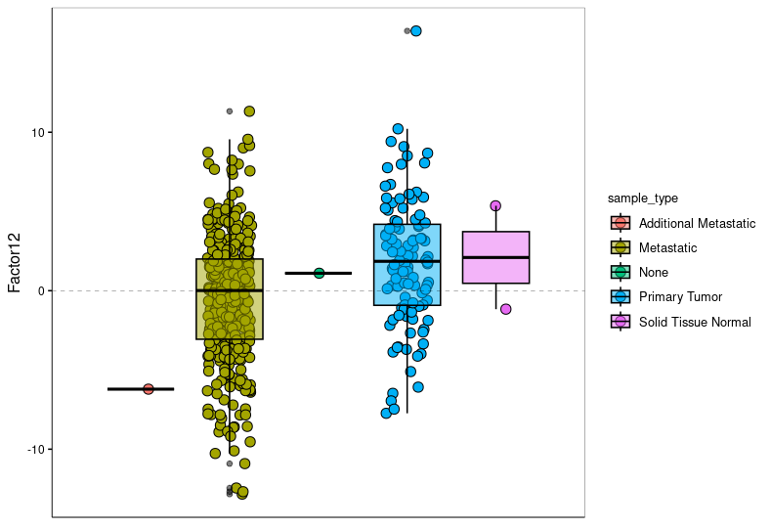
Trying to identify factors using metadata
Scatter plot of factor 12 grouped by New Tumor After Initial Treatment
Scatter plot of factor 12 grouped by Sample type

Slide 49
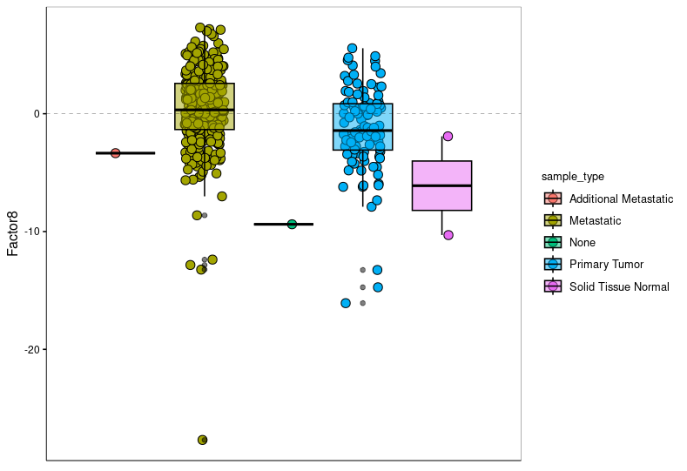
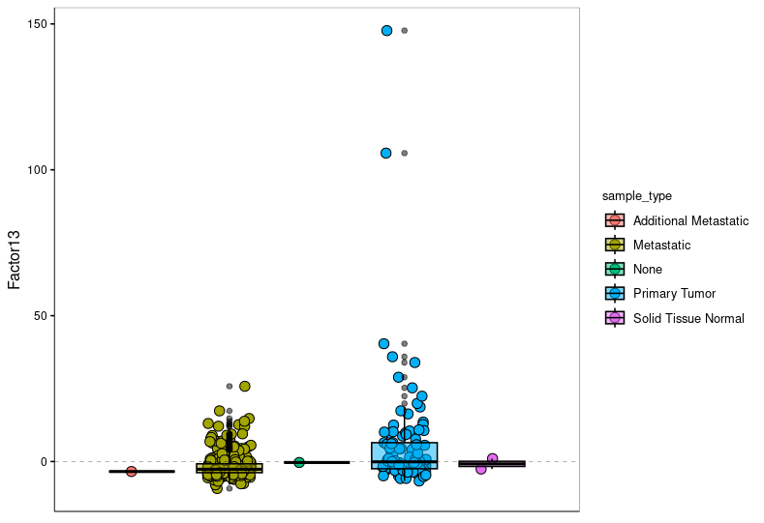
Trying to identify factors using metadata
Scatter plot of factor 8 grouped by Sample type
Scatter plot of factor 13 grouped by Sample type

Slide 50
Explaining variance
We found that MOFA 15 factors explain about 31% of variance in the given data.
Methylation explain about 28%, Expression about 3% and miRNA almost 0% of variance explained.

Slide 51
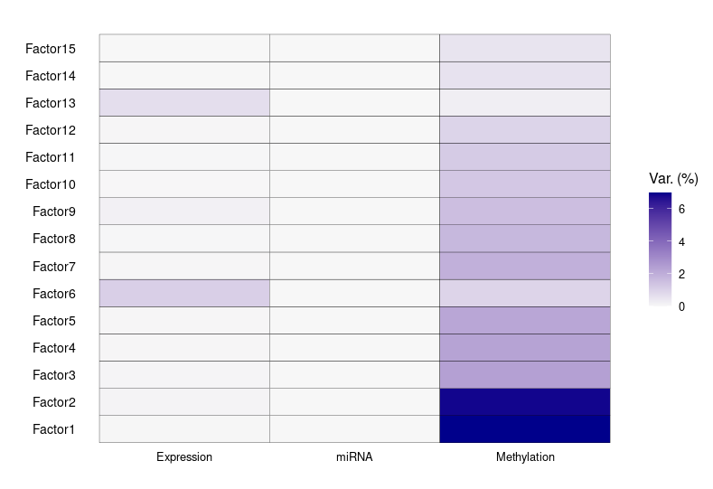
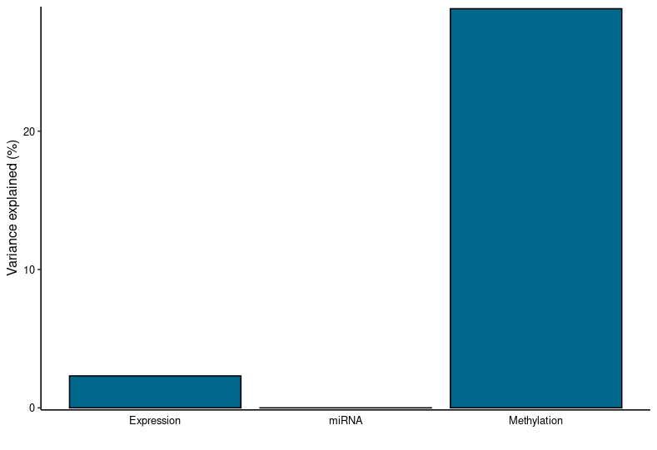
Explaining variance
Variance explained by different omics across all factors
Variance explained by different omics

Slide 52
Top Features weights
We are interested in factor 13 as it strongly correlates with one of the given covariates (Sample Type).
This factor captures about 0.9% of variability in our data with 0.66% for Expression and 0.23% for Methylation and almost 0% for miRNA.
We will investigate Top 10 features of each view for factor 13

Slide 53
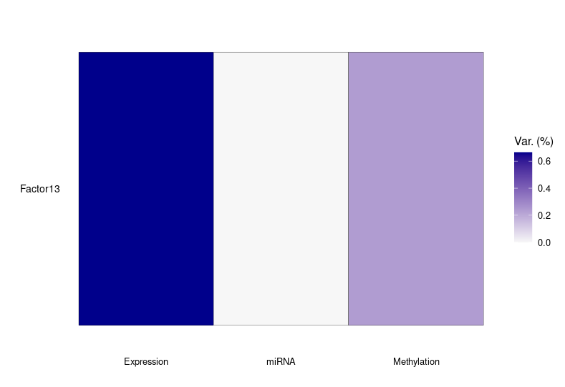
Top Features weights
Variance explained by different omics for factor 13

Slide 54
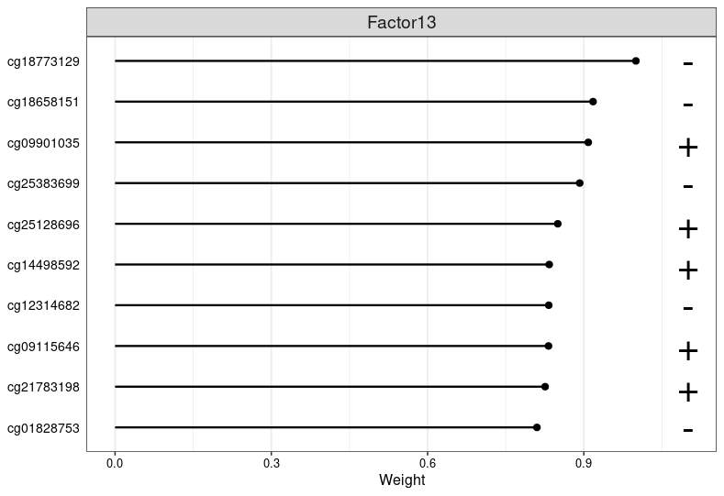
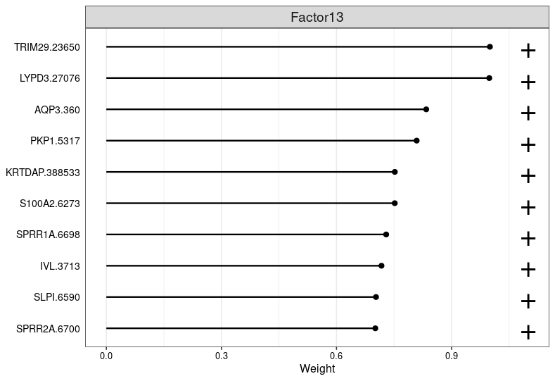
Top Features weights
Top 10 weights for Methylation features of factor 13
Top 10 weights for Expression features of factor 13

Slide 55
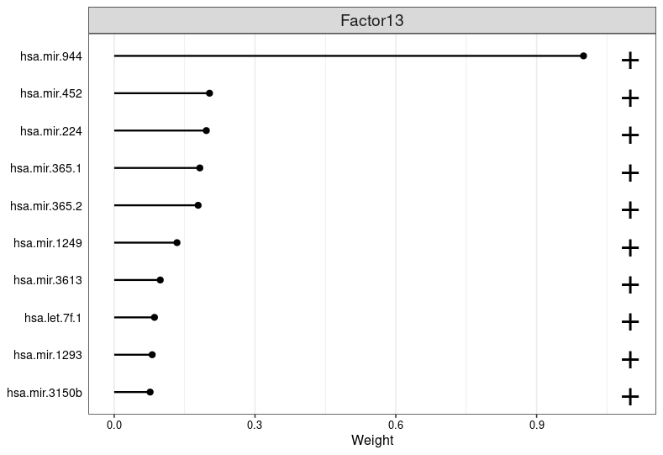
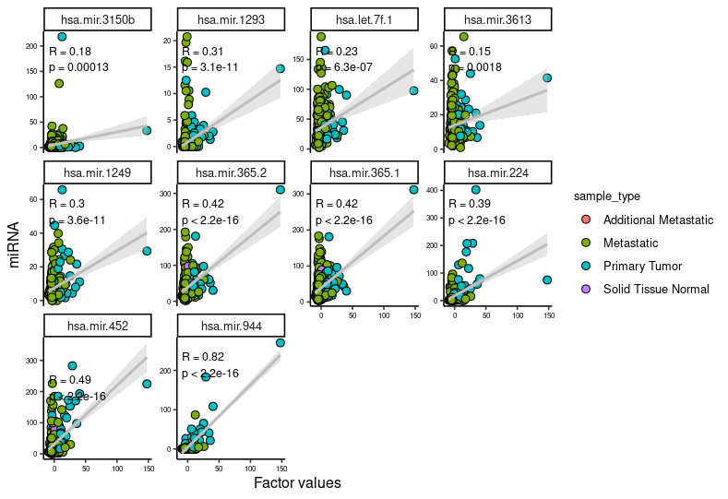
Top Features weights
Top 10 weights for miRNA features of factor 13
scatter plot for top 10 miRNA features plotted against factor 13 values

Slide 56


Top Features weights
scatter plot for top 10 Methylation features plotted against factor 13 values
scatter plot for top 10 Expression features plotted against factor 13 values

Slide 57


Slide 58


Slide 59


Slide 60
Top Features weights
We notice that there is some kind of cluster specially in top 10 features of expression view of factor 13 however we can’t say that it is a complete clustering.
We suggest maybe there is some kind of hidden structure in primary tumor samples that can be detected using supervised data clustering method

Slide 61
Functional enrichment analysis
Functional enrichment analysis for top 10 genes for factor 13 and factor 3 are done through gProfiler with the following options:
Organism: homo sapiens
Statistical domain scope: only annotated genes
Significance threshold: Bonferroni correction
User threshold: 0.05
Numeric IDs treated as: ENTREZENE_ACC

Slide 62

Functional enrichment analysis
According to the following Table the most significant biological process for the top 10 genes of factor 13 are associated with biological processes linked to skin development and differentiation which is maybe linked to the uncontrollable proliferation of skin cells that associated with melanoma.
The most significant biological process contributed to the top 10 genes of factor 13

Slide 63

Functional enrichment analysis
The most significant biological process contributed to the top 10 genes of factor 3

Slide 64
Functional enrichment analysis
According to the previous Table the most significant biological process for the top 10 genes of factor 3 are associated with biological processes linked to immunity.
We assume that those immunity biological processes are somehow linked to the vital status of our patients.

Slide 65
06
References

Slide 66
References
Grice EA, Segre JA. The human microbiome: our second genome. Annu Rev Genomics Hum Genet. 2012 Sep;13:151-70.
Human Microbiome Project Consortium. Structure, function and diversity of the healthy human microbiome. Nature. 2012 Jun 13;486(7402):207-14.
Sender R, Fuchs S, Milo R. Revised Estimates for the Number of Human and Bacteria Cells in the Body. PLoS Biol. 2016 Aug 19;14(8):e1002533.
Belkaid Y, Hand TW. Role of the microbiota in immunity and inflammation. Cell. 2014 Mar 27;157(1):121-41.
Round JL, Mazmanian SK. The gut microbiota shapes intestinal immune responses during health and disease. Nat Rev Immunol. 2009 May;9(5):313-23.
Thomas AM, Manghi P, Asnicar F, Pasolli E, Armanini F, Zolfo M, et al. Metagenomic analysis of colorectal cancer datasets identifies cross-cohort microbial diagnostic signatures and a link with choline degradation. Nat Med. 2019 Mar;25(4):667-78.
Pasolli E, Truong DT, Malik F, Waldron L, Segata N. Machine Learning Meta-analysis of Large Metagenomic Datasets: Tools and Biological Insights. PLoS Comput Biol. 2016 Nov 10;12(11):e1004977.
Love, M., Anders, S., & Huber, W. (2014). Differential analysis of count data–the DESeq2 package. Genome Biol, 15(550), 10-1186.
Kanehisa, M. (2002, November). The KEGG database. In ‘In silico’simulation of biological processes: Novartis Foundation Symposium 247 (Vol. 247, pp. 91-103). Chichester, UK: John Wiley & Sons, Ltd.
Argelaguet R, Velten B, Arnol D, Dietrich S, Zenz T, Marioni JC, Buettner F, Huber W, Stegle O (2018). “Multi‐Omics Factor Analysis—a framework for unsupervised integration of multi‐omics data sets.” Molecular Systems Biology.
Ratajczak, Mariusz & Ratajczak, Janina. (2021). Innate Immunity Communicates Using the Language of Extracellular Microvesicles. Stem Cell Reviews and Reports. 17. 10.1007/s12015-021-10138-6.

Slide 67
THANKS Do you have any question?

